Slide 1
Software Systems Design and Integration
Week 6
PUSH Architectures and AJAX

Slide 2
Content
XML as a Data Modeling Language
  Resources and Referencing them inside XML
  DOM Model
  Using the DOM model to parse XML
Web Model Revisited and PUSH Architecture
JavaScript, DOM & JSON: using the document and JSON objects
JavaScript and HTTP: using the XMLHttpRequest object
Roadmap for Developing AJAX application

Slide 3
1 XML as a data modeling language
Easy specification (simple tagging with possible prefixes and attributes only)
Easy transportation (text format only)
Easy processing (tags separated from data)
Allow referencing (prefixes, URLs, XML expressions)
Standardized (customized languages for specific domains of application)
  Banking and Financial Industries (BITS,IFX)
  Digital Libraries (CBL, MARC)
  Electronic Business (ebXML, bizTalk)
  The Text Encoding Initiative (TEI)

Slide 4
1.1 Resources and referencing them inside XML
XML documents can include reference to resources located in the same document, in other documents on the same host or on the Internet
Each XML reference is specified using expression in a language from the XML family of specifications:
  Xlink - Node names
  Xpointer - Tree nodes
  Xpath – Paths within trees
  XML Query - Sub-trees derived as a result of a query
Each expression should uniquely identify the resource so that it can be found on the Internet

Slide 5
1.2 DOM model
XML Documents are treated as a tree of nodes
Every item in the XML document is a "node" in the tree (both structural tags and attributes, as well as enclosed content text are nodes)
Child elements and enclosed text are sub-nodes of the parent nodes
Each node may have associated procedures for processing of the node
W3C DOM Site
http://www.w3.org/DOM/

Slide 6
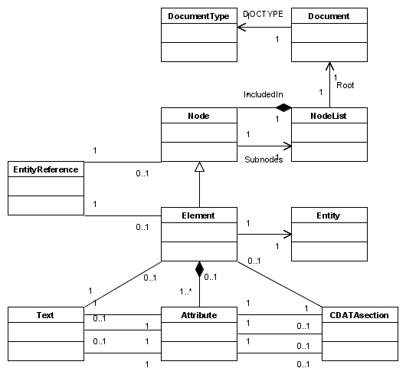
Fig. 1 Class diagram of the DOM model

Slide 7
Abstract DOM components
Element - An element object
Attribute - An attribute object
Text - Text content of an element or an attribute object
CDATAsection – [CDATA…]-section in an object
EntityReference - Reference to another entity object
Entity - Indication of a parsed or unparsed entity object
ProcessingInstruction – An instruction for processing a particular node in the tree
Document – An object representing the root element of the document
DocumentType - The <!DOCTYPE>-element object
Node – An object representing a single node in the tree
NodeList – An object representing list of nodes in the document tree

Slide 8
Characteristics of the DOM model
Represents both the content and the structure of an XML document in an abstract manner
Bi-directional mapping between the XML documents and their DOM model – convenient for transformation of XML data in other formats
Bindings exist for most of the programming languages (Java, C++, Perl, PHP, Python, C#, PL/SQL…); this allows processing of XML using its abstract DOM model
Java Language Binding for DOM
http://www.w3.org/TR/DOM-Level-2-Core/java-binding.html

Slide 9
1.3 Using DOM model for parsing XML
The document/stream is converted into a tree which has one-one correspondence with the original
The entire tree is placed in the memory
The tree can be processed further, transferred to other programs, even persisted into the memory

Slide 10
The API - DOMParser class
parse(String file)
parses the input source given by a system identifier
Document getDocument()
returns the document itself

Slide 11
Document Interface Methods
Attr createAttribute(String name)
Creates an attribute of the given name
Element createElement(String tagName)
Creates an element of the type given
Text createTextNode(String data)
Creates a Text Node
Element getDocumentElement()
Gets the root element of the document
Element getElementById(String elementId)
Get the element with the given ID
NodeList getElementsByTagName(String tagname)
Returns a NodeList of all the elements with a given tag name

Slide 12
NodeList Interface Methods
int getLength()
Gets the number of nodes in this list
Node item(int index)
Gets the item at the specified index value in the collection

Slide 13
Node Interface Methods
NamedNodeMap getAttributes()
Gets a NamedNodeMap with the attributes of this node
NodeList getChildNodes()
Gets a NodeList that contains all children of this node
String getLocalName()
Gets the local name of the node
String getNodeName()
Gets the name of this node
String getNodeValue()
Gets the value of this node
Node getParentNode()
Gets the parent of this node
short getNodeType()
Gets a code representing the type of the node

Slide 14
Node Types
static short ATTRIBUTE_NODE
static short CDATA_SECTION_NODE
static short COMMENT_NODE
static short DOCUMENT_FRAGMENT_NODE
static short DOCUMENT_NODE
static short DOCUMENT_TYPE_NODE
static short ELEMENT_NODE
static short ENTITY_NODE
static short ENTITY_REFERENCE_NODE
static short NOTATION_NODE
static short PROCESSING_INSTRUCTION_NODE
static short TEXT_NODE

Slide 15
Example: Parsing XML in Java
Semantic model specification (DOM tree or SAX event flow, depending on the parser; both model representation libraries can be added to Java SE)
Parser API (interfaces are included in Java SE so that different parser libraries can be plugged into the program without changing the code)
Parser implementation itself (e.g. Xerces – from Apache)
Note: Validation can be switched on/off

Slide 16
import org.w3c.dom.*;
import org.apache.xerces.parsers.DOMParser;
public class DOMTree{
public static void main(String[] args) { try {
DOMParser parser = new DOMParser(); parser.parse(args[0]);
Document doc = parser.getDocument();
// ... processing the DOM tree goes here ...
} catch (Exception e) { e.printStackTrace(System.err);
}
}
}

Slide 17
public class DOMWriter {
public static void toStream (Node startNode) {
if (startNode.getNodeType() == startNode.ELEMENT_NODE) {
System.out.print("<"+startNode.getNodeName());
NamedNodeMap startAttr = startNode.getAttributes();
for (int i = 0; i < startAttr.getLength(); i++) {
Node attr = startAttr.item(i);
System.out.print(" "+attr.getNodeName()+
"=\""+attr.getNodeValue()+"\"");
}
System.out.print(">");
} else if (startNode.getNodeType() == startNode.TEXT_NODE) {
System.out.print(startNode.getNodeValue());
}
for (Node childNode = startNode.getFirstChild();
childNode != null;
childNode = childNode.getNextSibling()){
toStream(childNode);
}
if (startNode.getNodeType() == startNode.ELEMENT_NODE) {
System.out.print("</"+startNode.getNodeName()+">");
}}}

Slide 18
Content
XML as a Data Modeling Language
Web Model Revisited and PUSH Architecture
  Information Processing in Classical Web Apps
  PUSH Architecture for Web Apps
JavaScript, DOM & JSON: using the document and JSON objects
JavaScript and HTTP: using the XMLHttpRequest object
Roadmap for Developing AJAX application

Slide 19
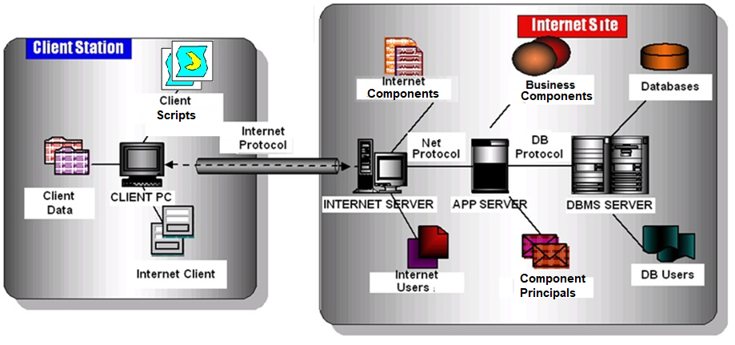
2 Web Model Revisited and PUSH Architecture
Fig. 2 Typical Internet Application Architecture

Slide 20
2.1 Information Processing in Web Apps
Client-server communications using HTTP
The server-side information processing includes
  retrieving data from the server host
  algorithmic processing of data on the server host
  exchanging data with third party applications
The client side information processing includes
  Validating the input data
  Formulating the HTTP request
  Extracting the data a from the HTTP response
  Rendering the data

Slide 21
Web Pages Lifeline
The page is either on the client (stored locally in a HTML file) or on the server (stored remotely in a Web file or generated dynamically by a Web application)
The client does some preprocessing and formulates an URL and requests it from the server
The server does some processing of the request and then returns an HTML page as a response to the client using HTTP

Slide 22
What is wrong with this model?
Typically the user actions in the browser trigger an HTTP request back to a web server.
While the server is doing its job, the user is waiting.
And even more: at every step of the process the user adds more waiting.
If the page content on the server is updated, the whole page on the client is reloaded again

Slide 23
2.2 PUSH Architecture for Web Apps
Idea: do not reload the whole pages from the server in a synchronous mode (upon external user request); parts of them can be loaded asynchronously (upon internal program event)
Further ideas: do not invoke the JavaScript only upon client/side events occuring while on the page, but also upon network communication events – e.g. when the response is delivered to the browser
Related solutions: possible with other client-side scripting languages – e.g. ActionScript, but they may require additional plug-ins for the browser
Asynchronous JavaScript And XML

Slide 24
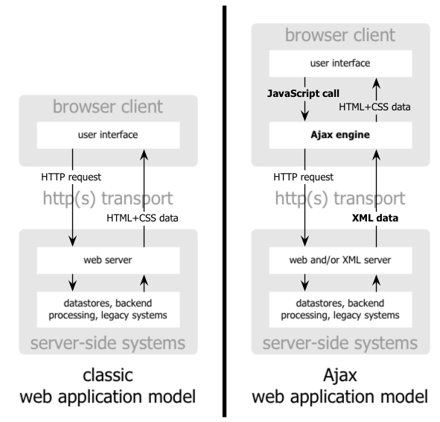
Classical Web Applications vs.
AJAX application
The same hardware
The same software
The same programming language
Extra layer in application software

Slide 25
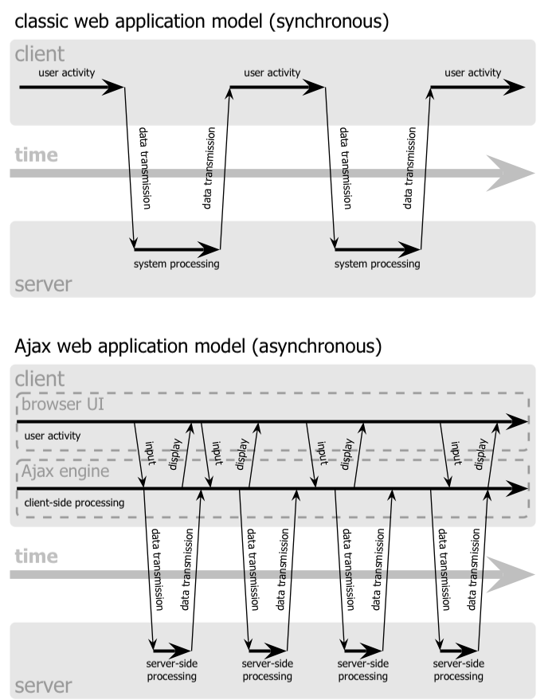
Synchronous vs. Asynchronous Web Models

Slide 26
Content
XML Semantics
Web Model Revisited
JavaScript, DOM & JSON
  JavaScript and DOM
  JavaScript and JSON
JavaScript and HTTP: using the XMLHttpRequest object
Roadmap for Developing AJAX application

Slide 27
3 JavaScript, DOM & JSON
DOM stands for Document Object Model; it is an abstract model of the documents, comprising a strict flow of information – typically top-down, from left to right
The XML processing methods available in JavaScript are identical to the XML processing methods in Java and in any other programming language (standard binding)
JavaScript uses predefined object document, which represents the document as DOM-tree to refer to the Web page it runs on

Slide 28
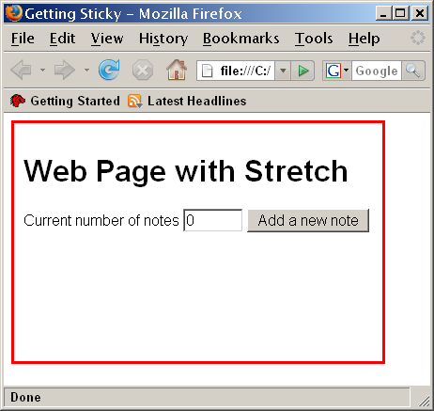
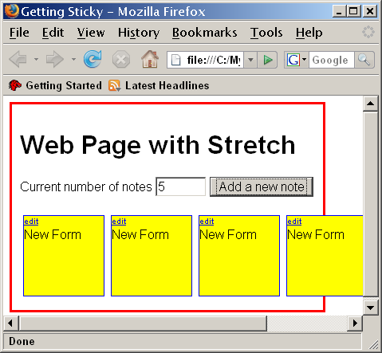
Example: Using DOM API to add information to a page
⇒

Slide 29
function makeNewNote(){
// accessing the main group element on the page
mainDivElement = document.getElementById("mainDiv");
// creating a new group element as a placeholder for note
newNote = document.createElement("div");
newNote.setAttribute("id","note"+getCurrentNumber());
…
editLink = getEditLink("note"+getCurrentNumber());
newNote.appendChild(editLink);
// populating the new note with content
newNote.appendChild(document.createElement("br"));
noteText = document.createTextNode("New Form");
newNote.appendChild(noteText);
// appending the new note element to the main element
mainDivElement.appendChild(newNote);
incrementCurrent();
}

Slide 30
JSON or JavaScript Object Notation
JSON is a text format for representing objects using JavaScript as named value pairs
{"firstName":"John", "lastName":"Doe"}
JSON supports also arrays of JSON objects
"employees":[
{"firstName":"John", "lastName":"Doe"},
{"firstName":"Anna", "lastName":"Smith"},
{"firstName":"Peter", "lastName":"Jones"}
]
JSON objects can be transported over HTTP to the server, processed by RESTful Web Services and stored in different databases

Slide 31
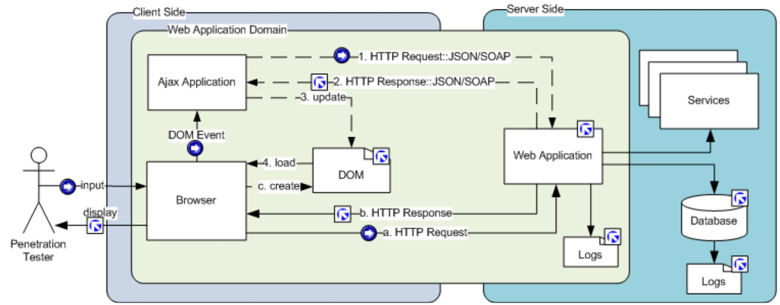
Example: Using JSON objects to transport data from server file logs

Slide 32
Content
XML Semantics
Web Model Revisited
JavaScript, DOM & JSON
JavaScript and HTTP
  XMLHttpRequest Object and Creating HTTP requests in JavaScript
  Submitting the request and callback function for processing the HTTP response
Roadmap for Developing AJAX application

Slide 33
4 JavaScript and HTTP
JavaScript may request an URL without waiting for the response
The Web browser intercepts the request, establishes connection and communicates with the Web server
When the browser receives the response from the server, it passes it back to the JavaScript function

Slide 34
JavaScript Objects for HTTP communications
Created on demand
xmlHttp = new ActiveXObject("Microsoft.XMLHTTP")
Different and specific for the browser
XMLHttpRequest(…) – for Mozilla, Safari, Chrome
ActiveXObject(…) – for Internet Explorer

Slide 35
Creating the HTTP request object in JavaScript
creating of n HTTP request object on demand
  For Mozzila-type browsers
<script language="javascript"
type="text/javascript">
var xmlHttp = new XMLHttpRequest();
</script>
  For Microsoft IE-type of browsers
<script language="javascript"
type="text/javascript">
var xmlHttp =
new ActiveXObject("Microsoft.XMLHTTP")
</script>

Slide 36
Example: Making the AJAX request using JavaScript
function callServer() {
// Get the city and state from the web form
…
// Build the URL to connect to
var url = "/scripts/getZipCode.php?city=" +
escape(city) + "&state=" + escape(state);
// Open a connection to the server
xmlHttp.open("GET", url, true);
// Set callback function to run when it's done
xmlHttp.onreadystatechange = updatePage;
// Send the request
xmlHttp.send(null);
}

Slide 37
Starting the AJAX engine
The AJAX entry can be attached to any event handler on the page – mouse, button, etc.
Initial user activity will trigger the AJAX process
<form>
<p>City:
<input type="text" name="city" id="city" size="25"
onChange="callServer();" /></p>
<p>State:
<input type="text" name="state" id="state" size="25"
onChange="callServer();" /></p>
<p>Zip Code:
<input type="text" name="zipCode" id="zip" size="5"
/></p>
</form>

Slide 38
Processing the response in JavaScript
The response of the server is passed to a callback function for processing
The callback function is invoked automatically by the browser after receiving the response
The callback function controls the status and retrieves the response object
function updatePage() {
if (xmlHttp.readyState == 4) {
var response = xmlHttp.responseText;
document.getElementById("zip").value=
response;
}
}

Slide 39
Content
XML Semantics
Web Model Revisited
JavaScript, DOM & JSON
JavaScript and HTTP
Roadmap for Developing AJAX applications
  Layer components
  Comparison with the classical model

Slide 40
5. Roadmap for Developing AJAX Web applications
Layer 1 – Web client
HTML request generation
<form method = “GET” action =“getUpdate”>
<input type="text"
name="phone"
id="phone"
onChange="getCustomerInfo();" />
...
</form>

Slide 41
Browser support
Two main roles
  Intercepts JavaScript requests and sends them to the Web server
  Receives the Web server responses and passes them back to the requesting JavaScript
Consequences
  Eliminating the user (no buttons, no clicks, no waiting)
  Establishing new connections (new session)

Slide 42
HTML/CSS support
Grouping of HTML elements into a homogeneous fragment to be styled with one CSS rule:
Page:
<div id = “modules”>
  <a href=“mmp002c.html”>Web Design</a>
  <a href=“mmp003c.html”>E-Commerce</a>
  <a href=“mmp004c.html”>Mobile Computing</a>
  </div>
Screen:
  Web Design
  E-Commerce
  Mobile Computing

Slide 43
Grouping of HTML elements into a heterogeneous fragment to be styled with several CSS rules
Page:
  <div id = “textbook”>
<ul>
<li><span class=“author”>Deitel</span>,
<span class=“title”>How-to-Program</span>
<li><span class=“author”>McLaughlin</span>,
<span class=“title”>Head Start</span>
</ul>
  </div>
Screen:
  Deitel, How-to-Program
  McLaughlin, Head Rush

Slide 44
JavaScript support
accessing the Web page elements (through its DOM)
initiating the communications with the Web server programmatically according to the programmed logic (by opening new connection)
concluding the communications programmatically according to the logics of the network events (by invoking the callback function)
dynamic reconstruction of the pages out of the elements as they arrive (through its DOM)

Slide 45
Layer 2 – AJAX engine
JavaScript request despatch
  var phone =
  document.getElementById(“id”).value;
  var url = “getInfo?id=“ +
  escape(id);
  request.open(“GET”,url,true);
  request.onreadystatechange=updateInfo;
  request.send(null);
JavaScript response processing
  if (request.readyState == 4){
  var info = request.responseText;
  …
  /* Update the HTML page */
  }

Slide 46
Layer 3 – Web server
HTTP Request object
  Created automatically by the Web server as a result of the HTTP request received
  Dispatched to the corresponding server-side script for processing (PHP, Java, JSP, ASP, etc.)

Slide 47
Layer 4 – Servlet
Extracting the information from HTTP Request object
  phone = request.getParameter(“phone”);
Returning the information from the server
out.println(...);

Slide 48
How do the two models of Web applications compare?
  Functionality
  Usability
  Reliability
  Security
  Efficiency
  Complexity

Slide 49
Classical vs. AJAX Web Applications
Classical Web App
AJAX Web App
- Not flexible enough, the user can get frustrated
+ More reliable because the functionality is implemented in a simple way
+ More secure because all activities on the page are under user control
± Looks less efficient (the communications are page-based), but they are less often
+ Much simpler to implement, easier to debug
+ Better usability
- Less reliable because the functionality depends on JavaScript
- Less secure due to the uncontrolled network connections
± Looks more efficient because only data fragments are returned, but it increases the network traffic
- More complex to implement, difficult to debug

Slide 50
Resources
[1] Nicholas Chase, JavaScript and the Document Object Model. http://www-128.ibm.com/developerworks/ajax
[2] Paul Deitel, Harvey Deitel. AJAX, Rich Internet Applications, and Web Development For Programmers. Prentice Hall (2008)
[3] Jeff Friesen, Java XML and JSON. Apress (2016)

